Slide 1


Alzheimer's Assistance using Geofencing

Slide 2

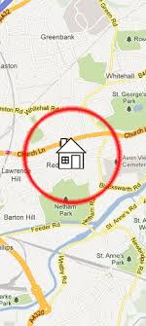

Objective
The objective of an Alzheimer's assistance system using an Arduino Nano with geofencing is to monitor the movements of individuals and send alerts to caregivers or family members if they cross predefined boundaries.
The system uses sensors and algorithms to identify range and triggers alerts to caregivers or emergency services so that prompt assistance can be provided.
This helps in reducing the risks and consequences of wandering in individuals with Alzheimer's disease, ensuring their safety and well-being.

Slide 3
Components
1) Ardino Nano
2) Neo 6M Gps module
3) Sim 800L Gsm
3) Connection jumper pins
4) USB to type A connector
5) Arduino software
6) Power Source
7) Buzzer

Slide 4

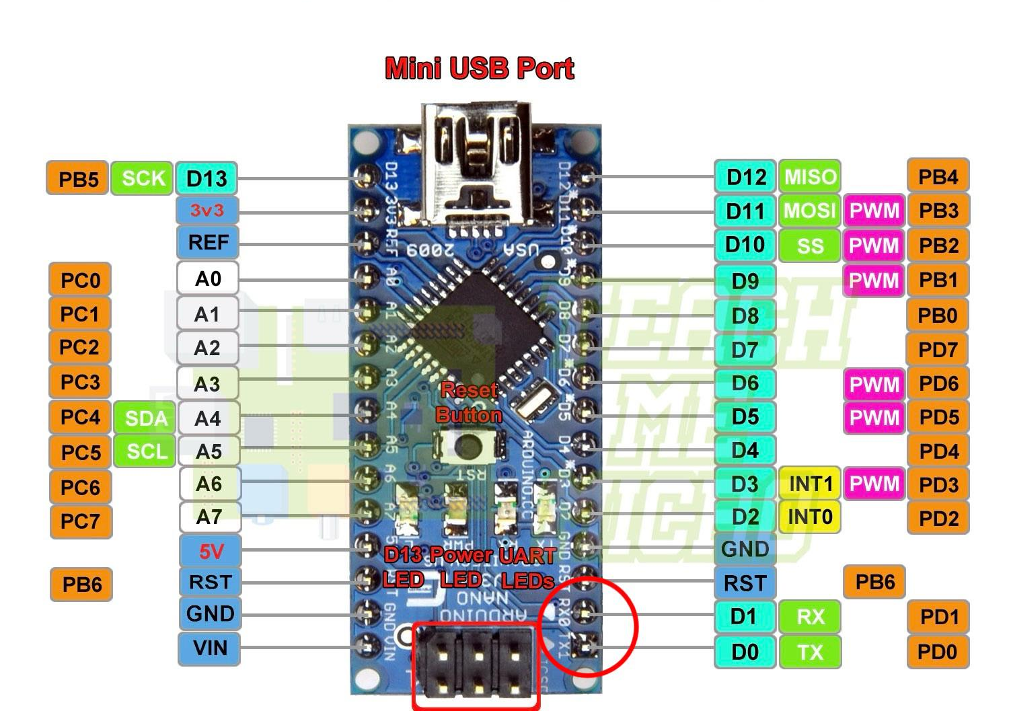
ARDUINO NANO

Slide 5
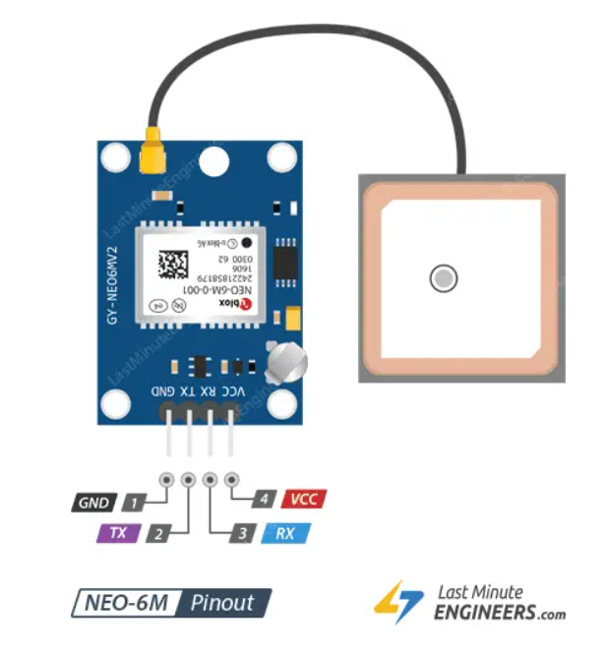
NEO
6M

Slide 6
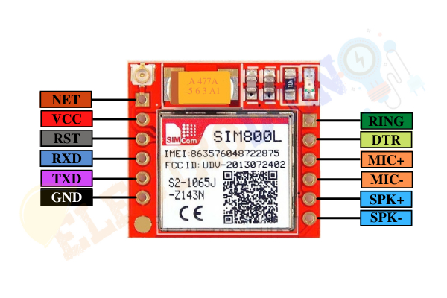
SIM 800L

Slide 7
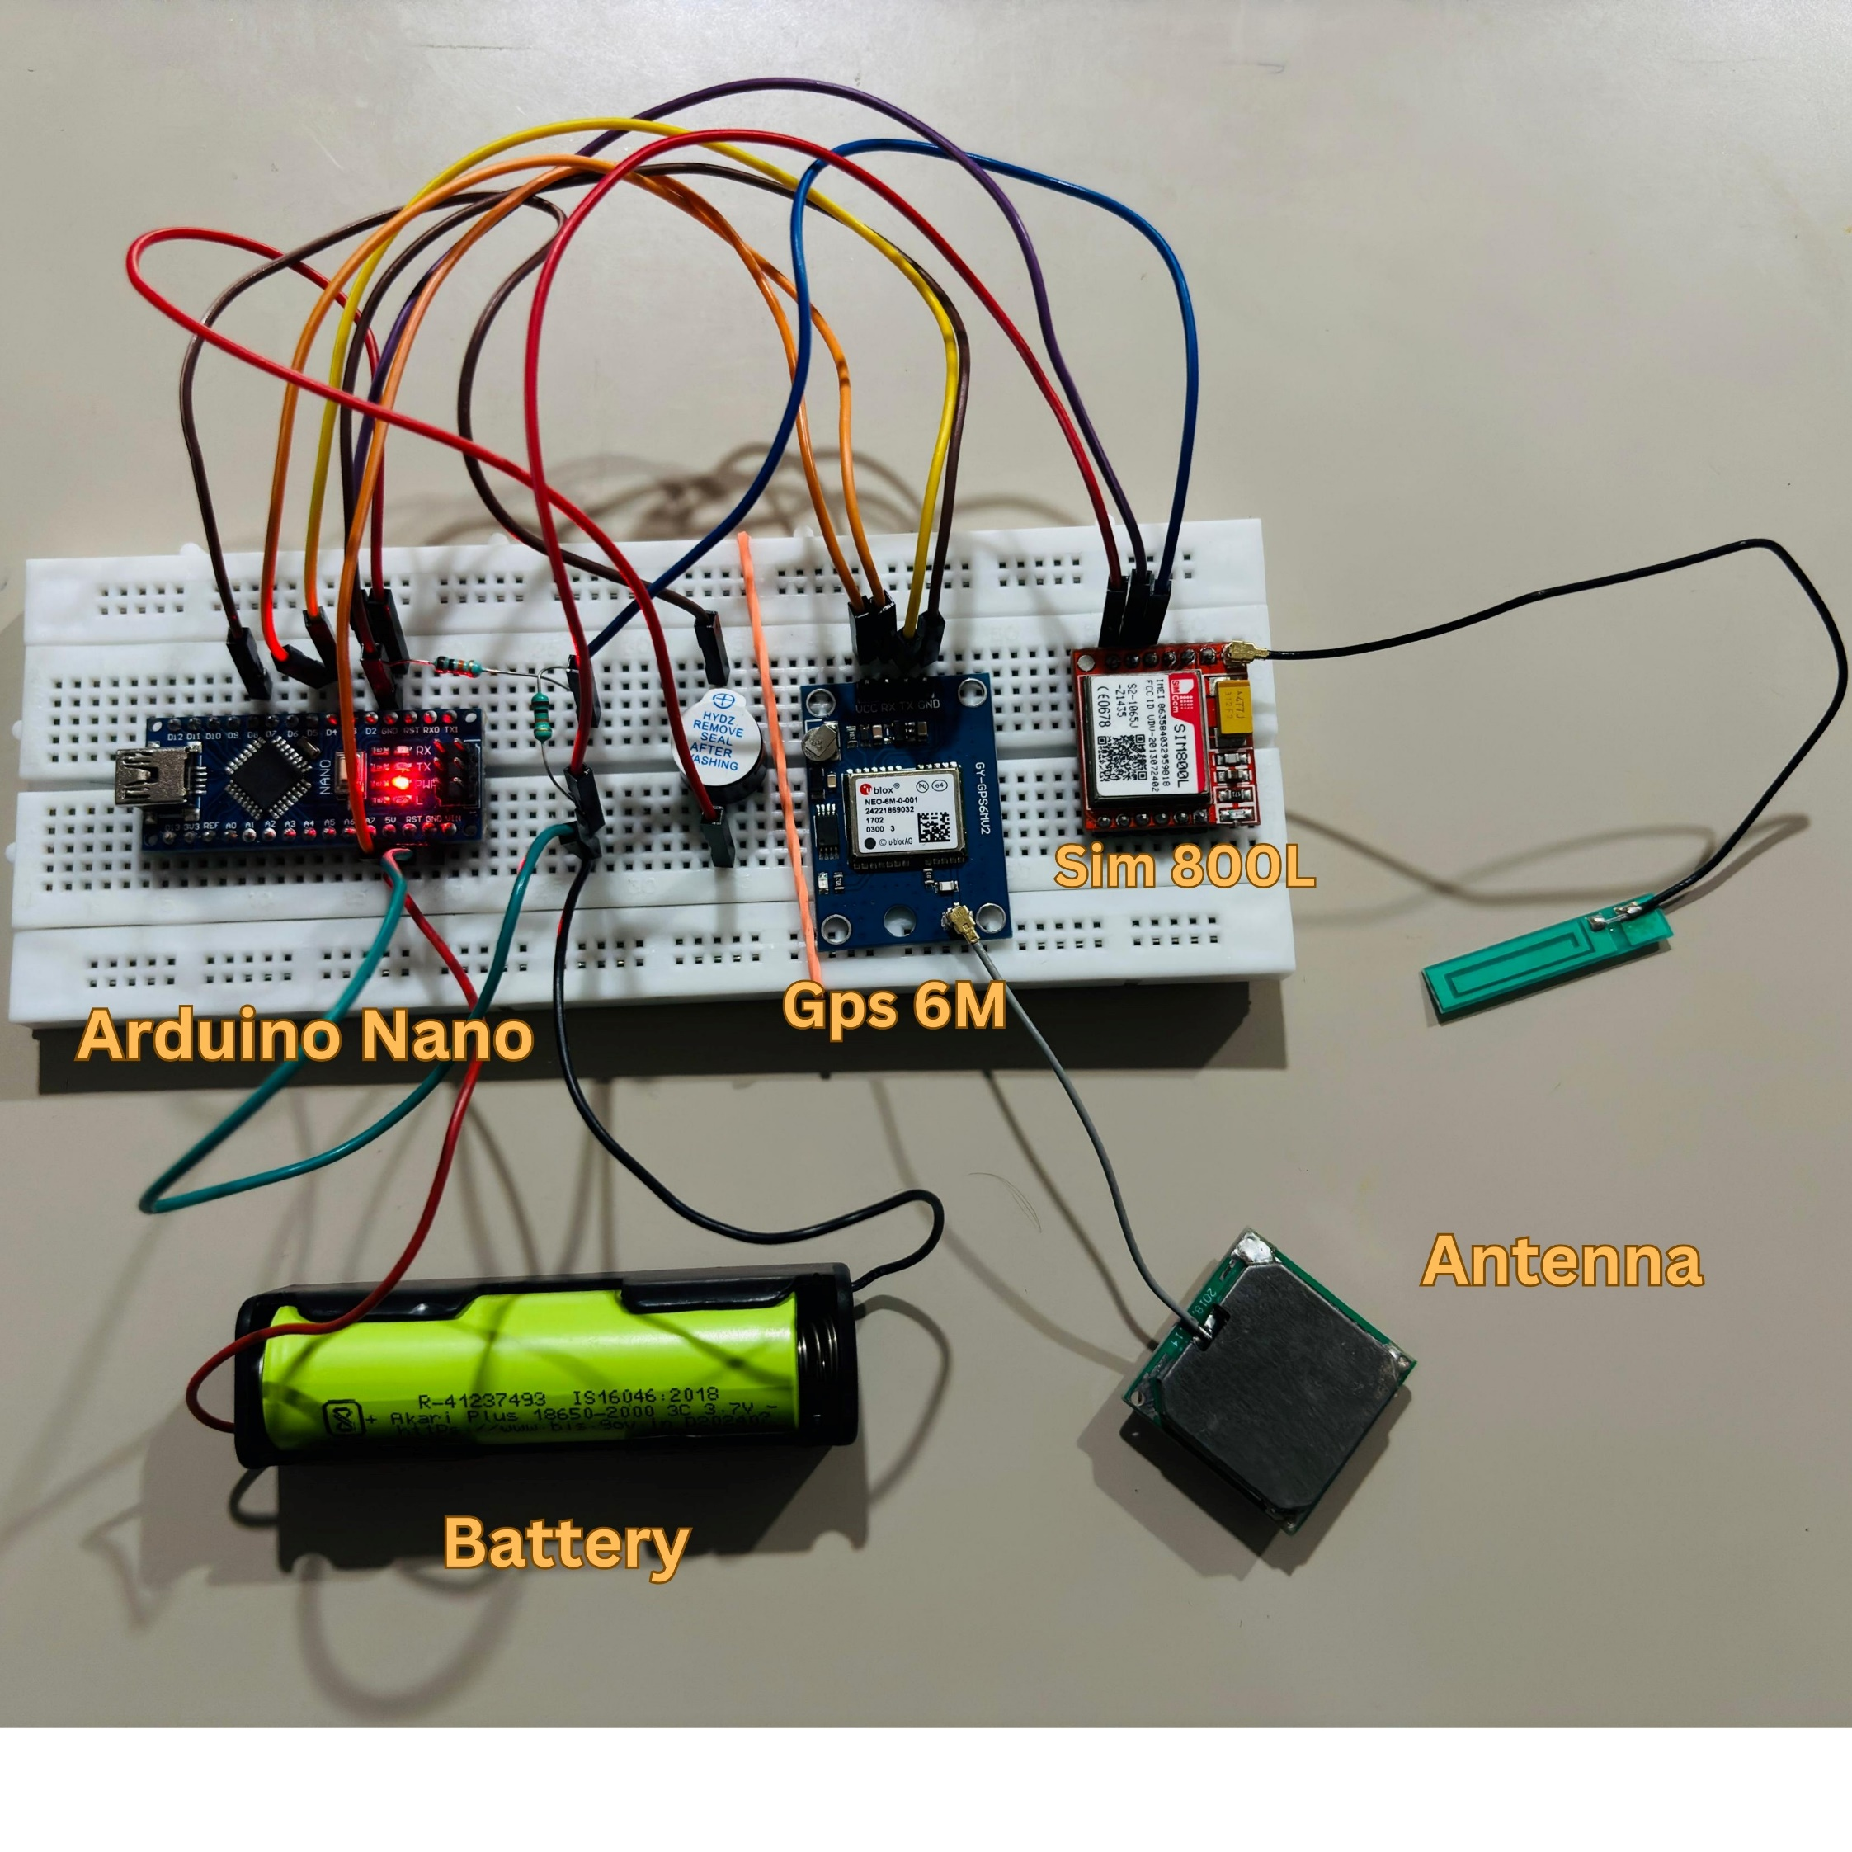
Connections

Slide 8
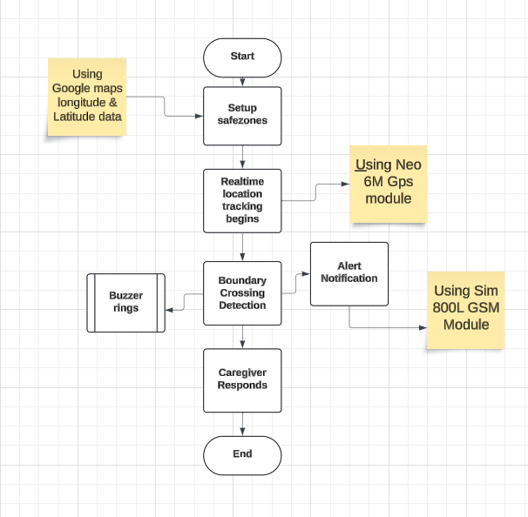
Workflow

Slide 9
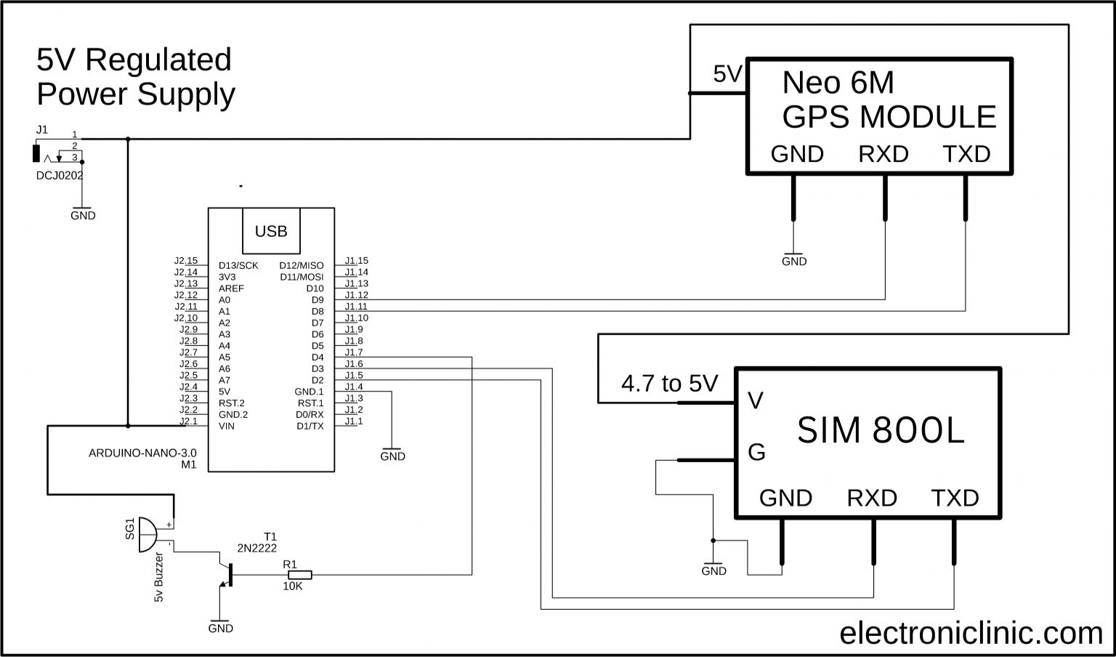
Circuit Diagram

Slide 10
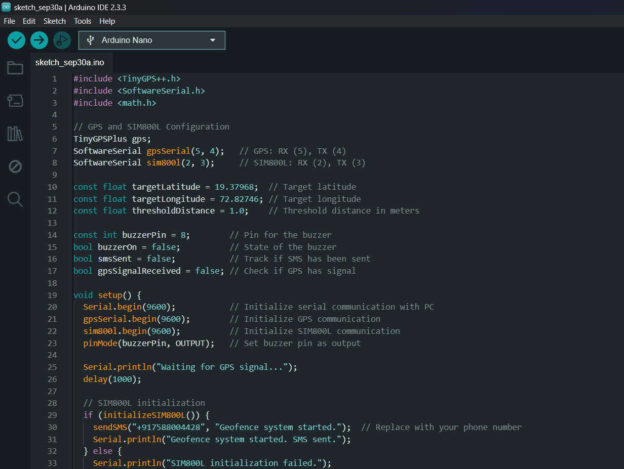
Code

Slide 11
Advantages of using Alzheimer's Assistance
1. Enhanced Safety
Geofencing allows caregivers to set virtual boundaries around safe areas (like home or nearby surroundings). When a person with Alzheimer's crosses these boundaries, an alert is triggered, enabling a quick response to prevent wandering or getting lost.
2. Increased Independence for Patients
Patients can have more freedom to move around within safe zones, supporting a degree of independence while still being monitored for safety.
3. Customizable Alerts
Alerts can be customized for different times of day or specific zones, helping caregivers to be aware of potential risks based on routine behaviors or known wandering patterns.
4. Data Insights for Better Care
Geofencing systems can provide data on movement patterns, allowing caregivers and medical professionals to gain insights into the patient’s behavior, potentially identifying changes in condition or habits that may need attention.
5. Facilitates Emergency Response
Quick alerts and location tracking can facilitate faster response times in emergencies, such as when a patient is lost or in a potentially dangerous situation..

Slide 12
Thank You

